Slide 1
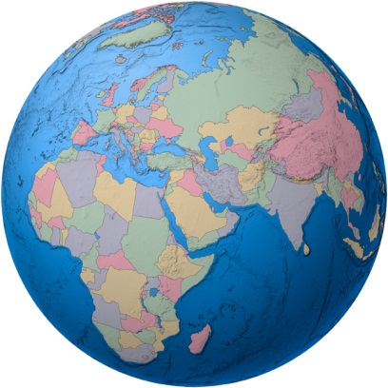
CHINA STUDY CIRCLE
Session # 14 (March 8 2018)
MONTHLY UPDATE
Islamabad’s Informal
Fourteen Session

Slide 2
Session # 14 (March 8 2018)
MONTHLY UPDATE
AGENDA
1- Networking of Participants and special guests of the session
2-Monthly Update on CPEC and OBOR: Projects, Perceptions, Periodicals/Literature
3-Selected Item of the Fundamentals to Study China
4-Formal and Informal Discussion Period

Slide 3
Session # 14 (March 8 2018)
MONTHLY UPDATE
OBOR
NOTABLE PUBLICATIONS OF THE LAST QUARTER Neelum Javed

Slide 4
Session # 14 (March 8 2018)
MONTHLY UPDATE
OBOR - NOTABLE PUBLICATIONS OF THE LAST QUARTER
Source:https://www.csis.org/analysis/chinas-belt-and-road-initiative-five-years-later-0

Slide 5
Session # 14 (March 8 2018)
MONTHLY UPDATE
OBOR - NOTABLE PUBLICATIONS OF THE LAST QUARTER
Source:www.australiachinarelations.org/sites/default/files/20171109%20ACRI%20Research_Decision%20Time_Australia%27s%20engagement%20with%20China%27s%20Belt%20and%20Road%20Initiative.pdf

Slide 6
Session # 14 (March 8 2018)
MONTHLY UPDATE
OBOR - NOTABLE PUBLICATIONS OF THE LAST QUARTER
Source: http://china-trade-research.hktdc.com/business-news/article/The-Belt-and-Road-Initiative/Chinese-Investment-in-Europe-A-Country-Level-Approach/obor/en/1/1X3CGF6L/1X0AD0R9.htm

Slide 7
Session # 14 (March 8 2018)
MONTHLY UPDATE
OBOR - NOTABLE PUBLICATIONS OF THE LAST QUARTER

Slide 8
Session # 14 (March 8 2018)
MONTHLY UPDATE
OBOR - NOTABLE PUBLICATIONS OF THE LAST QUARTER

Slide 9
Session # 14 (March 8 2018)
MONTHLY UPDATE
OBOR - NOTABLE PUBLICATIONS OF THE LAST QUARTER

Slide 10
Session # 14 (March 8 2018)
MONTHLY UPDATE
OBOR - NOTABLE PUBLICATIONS OF THE LAST QUARTER
Source:https://www.clingendael.org/sites/default/files/pdfs/Europe_and_Chinas_New_Silk_Roads_0.pdf

Slide 11
Session # 14 (March 8 2018)
MONTHLY UPDATE
OBOR - NOTABLE PUBLICATIONS OF THE LAST QUARTER
Source:https://www.clingendael.org/sites/default/files/pdfs/Europe_and_Chinas_New_Silk_Roads_0.pdf

Slide 12
Session # 14 (March 8 2018)
MONTHLY UPDATE
OBOR - NOTABLE PUBLICATIONS OF THE LAST QUARTER

Slide 13
Session # 14 (March 8 2018)
MONTHLY UPDATE
OBOR - NOTABLE PUBLICATIONS OF THE LAST QUARTER
China’s Belt and Road Initiative: Regional Outlooks for 2018
by Global Risk Insights , January 31, 2018
co-authored by Joanna Eva, Qi Lin, and James Tunningley, focuses on the 2018 outlook for different regions receiving Chinese investment.
Source:https://globalriskinsights.com/2018/01/chinas-belt-and-road-initiative-regional-outlooks-for-2018/

Slide 14
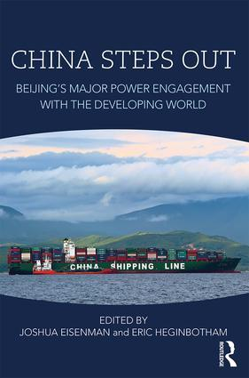
Session # 14 (March 8 2018)
MONTHLY UPDATE
OBOR - NOTABLE PUBLICATIONS OF THE LAST QUARTER
Source: https://www.csis.org/events/book-launch-china-steps-out-beijings-major-power-engagement-developing-world

Slide 15
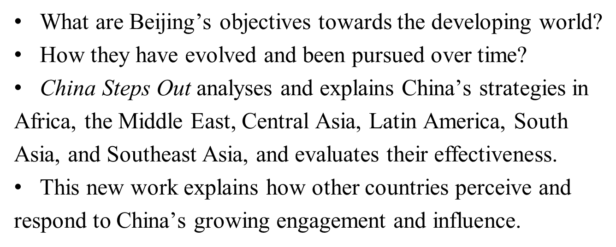
Session # 14 (March 8 2018)
MONTHLY UPDATE
OBOR - NOTABLE PUBLICATIONS OF THE LAST QUARTER

Slide 16
THANK YOU

